Slide 1
Start with python
Session 2
AUG

Slide 2


Agenda
A
Strings
Tuples
Lists

Slide 3
What is a string?

Slide 4

String
A string in python is a sequence of characters.
It can be considered as an array or a list of characters.
It can be a word or a phrase (it can include spaces).
Quotes:
1) Single → print( ‘ Hello World ’ )
2) Double → print( “ Hello World ” )
3) Triple → ‘’’Multiple “”” Multiple # single line comment
line line
comment ‘’’ comment “””
H e l l o
‘Hello’ $≡$ “Hello”
or

Slide 5

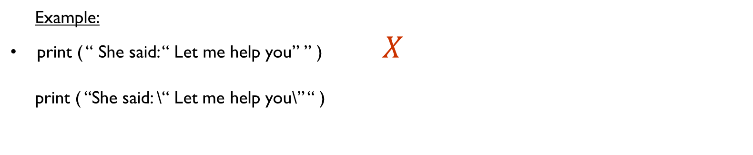
Escape characters ( \’ , \” , \\ , \n , \t )
\’ → Single quotes
\” → Double quotes
\n → newline
\t → Tab ( 4 to 5 spaces)
Example:
print ( “ She said: “ Let me help you” ” ) $X$
print ( “She said: \“ Let me help you\” “ )
Output
She said: “ Let me help you”

Slide 6
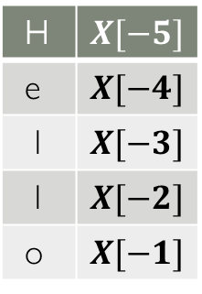
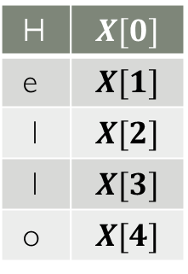
Indexing and Slicing
Indexing: Let : x = ‘Hello’
It’s used to access a single character.
0 1 2 3 4 . -5 -4 -3 -2 -1
H e l l o H e l l o
Ex: print ( x[0] )
>> H
Slicing: Let : x = ‘Hello’
It’s used to access a single character or a substring.
0 1 2 3 4 . -5 -4 -3 -2 -1
Ex:
1) print (x [ 1st index : 2nd index - 1 ] ) 2) print (x [ : ] )
print ( x [ 2: 4 ] ) >> Hello
>> ll # print the
whole string.
3) print (x [ 1st index : ] )
print ( x [ -3 : ] ) # from a specific index
>> llo till the end.
4) print (x [ : 2nd index - 1 ] )
print ( x [ : 4 ] ) # from the beginning
>> Hell till a specific index.
String_name[ Initial : End : IndexJump ]
H e l l o
H e l l o
H e l l o
H e l l o
H | $$X[0]$$
e | $$X[1]$$
l | $$X[2]$$
l | $$X[3]$$
o | $$X[4]$$
H | $$X[−5]$$
e | $$X[−4]$$
l | $$X[−3]$$
l | $$X[−2]$$
o | $$X[−1]$$

Slide 7
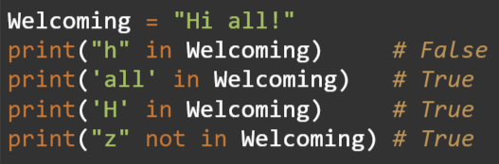
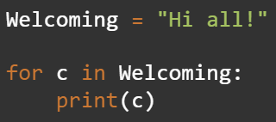
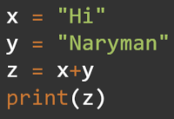
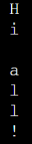
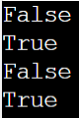
Errors
Ex: s = “Berry”
char = fruit[5]
2) s[0] = ‘h’
Strings are
immutable
In keyword Iterating through String
a String Concatenation
Output:
Output:
Output:

Slide 8
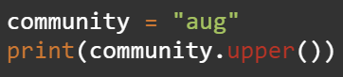
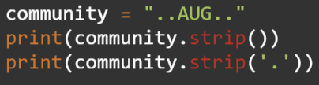
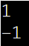
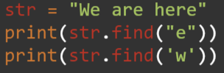
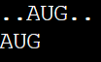
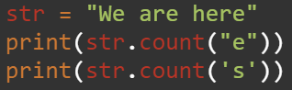
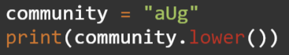
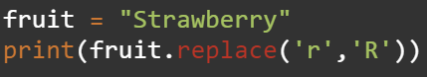
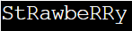
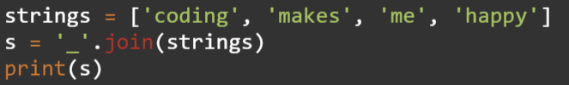
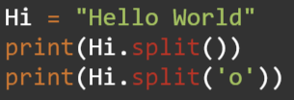
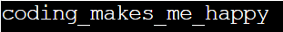
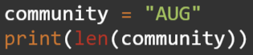
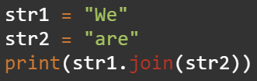
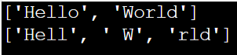
Important built-in functions
. upper( )
Output:
. lower( )
Output:
. len ( string )
Output: 3
. strip( )
Output:
. replace( arg1, arg2 )
Output:
. split( )
Output:
. find( string )
Output:
. count( string )
Output:
. join( list of strings )
Output:
Output: aWerWee
We will talk about it later in lists section.

Slide 9
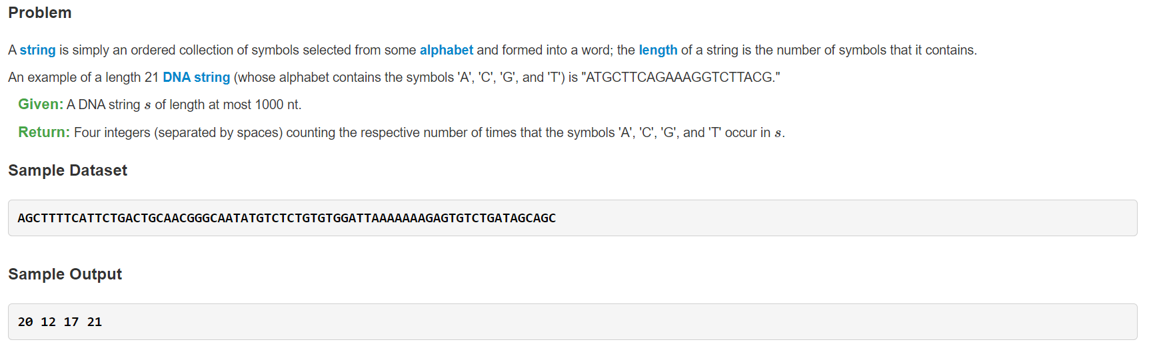
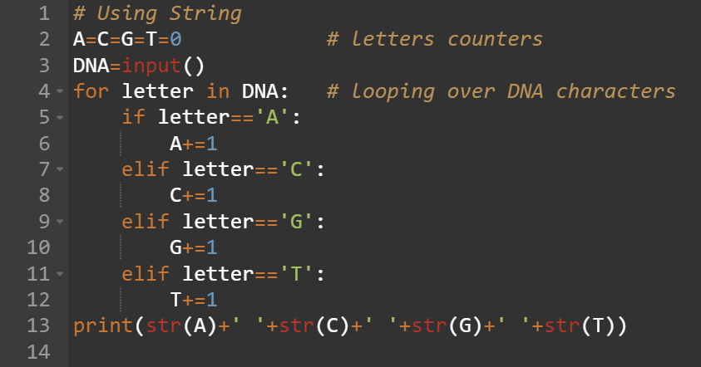
Task 1
Will we submit this code as it is on Rosalind?
No

Slide 10
How to submit your answer on Rosalind?

Slide 11
Break
5 minutes break

Slide 12

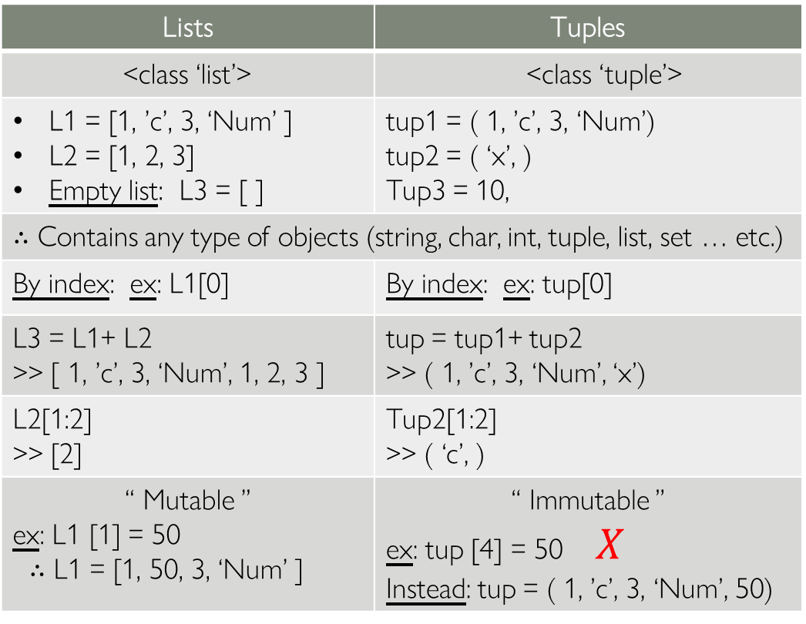
Lists vs Tuples
It’s preferred that the list elements are of the same data type
Lists | Tuples
<class ‘list’> | <class ‘tuple’>
L1 = [1, ’c’, 3, ‘Num’ ] L2 = [1, 2, 3] Empty list: L3 = [ ] | tup1 = ( 1, ’c’, 3, ‘Num’) tup2 = ( ‘x’, ) Tup3 = 10,
∴ Contains any type of objects (string, char, int, tuple, list, set … etc.) | ∴ Contains any type of objects (string, char, int, tuple, list, set … etc.)
By index: ex: L1[0] | By index: ex: tup[0]
L3 = L1+ L2 >> [ 1, ’c’, 3, ‘Num’, 1, 2, 3 ] | tup = tup1+ tup2 >> ( 1, ’c’, 3, ‘Num’, ‘x’)
L2[1:2] >> [2] | Tup2[1:2] >> ( ‘c’, )
“ Mutable ” ex: L1 [1] = 50 ∴ L1 = [1, 50, 3, ‘Num’ ] | “ Immutable ” ex: tup [4] = 50 $X$ Instead: tup = ( 1, ’c’, 3, ‘Num’, 50)
type ( ) :
Example :
Accessing there elements:
Concatenation:
Slicing:
Mutability:
The comma indicates it’s a tuple
Values of tuple can’t change once created.
You can only override the whole tuple.

Slide 13
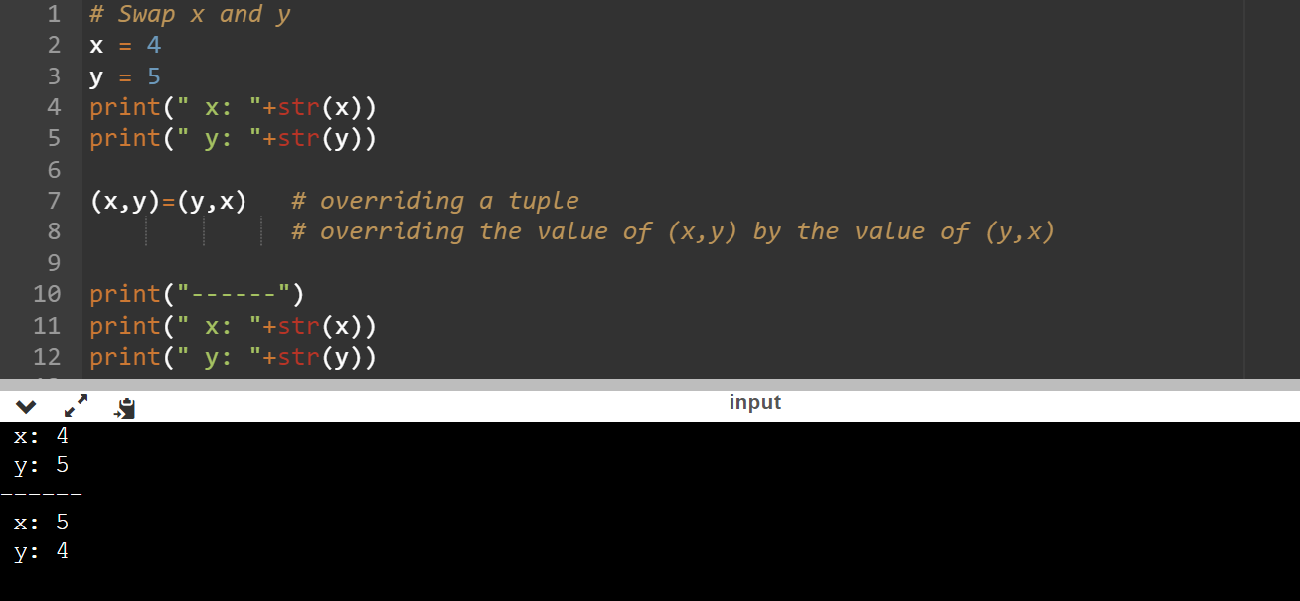
Task 2 “Tuples”
Example 1: You are given 2 numbers swap them using tuples:

Slide 14
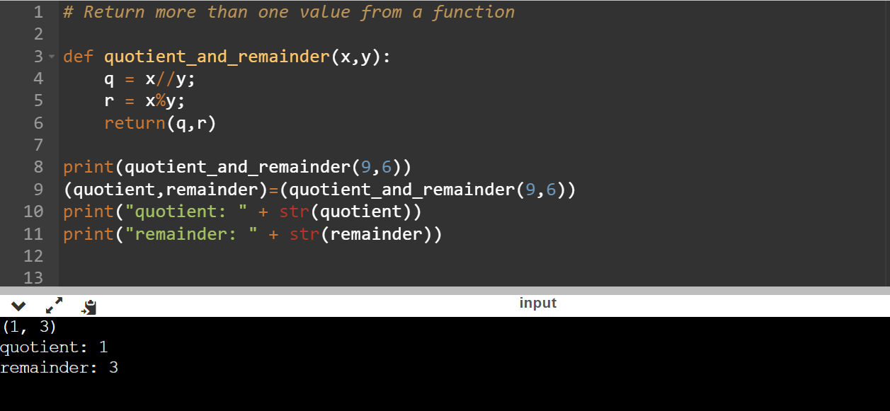
Task 3 “Tuples”
Example 2: “Return more than one value from a function”
You will be given two variables x and y, return: 1) quotient
: 2) remainder

Slide 15
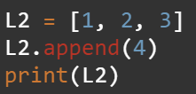
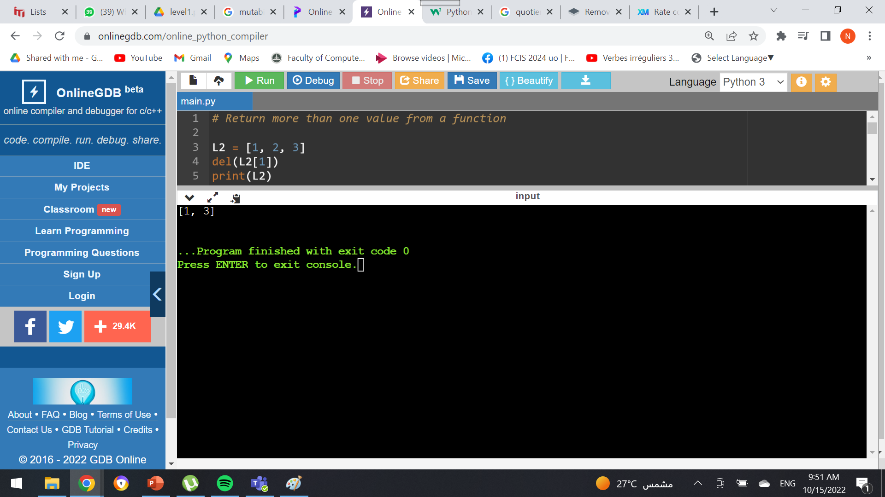
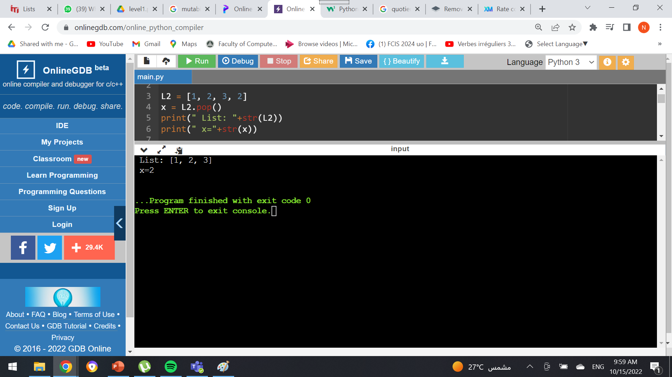
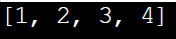
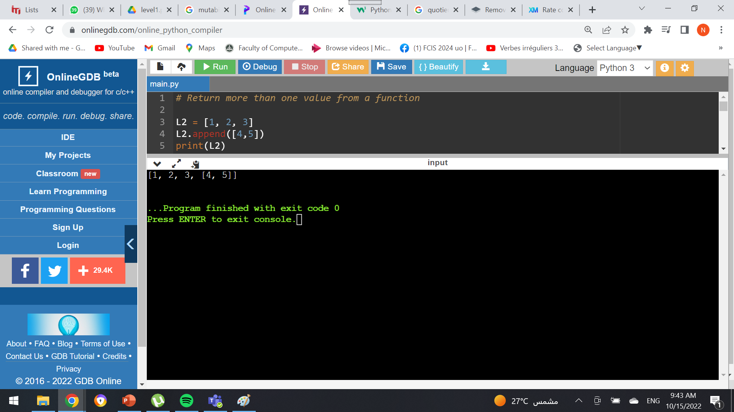
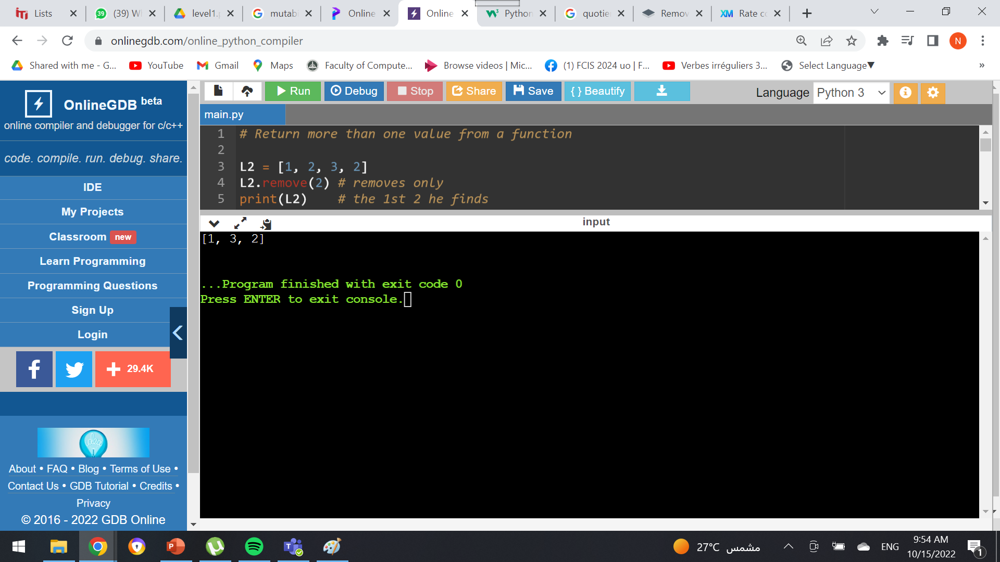
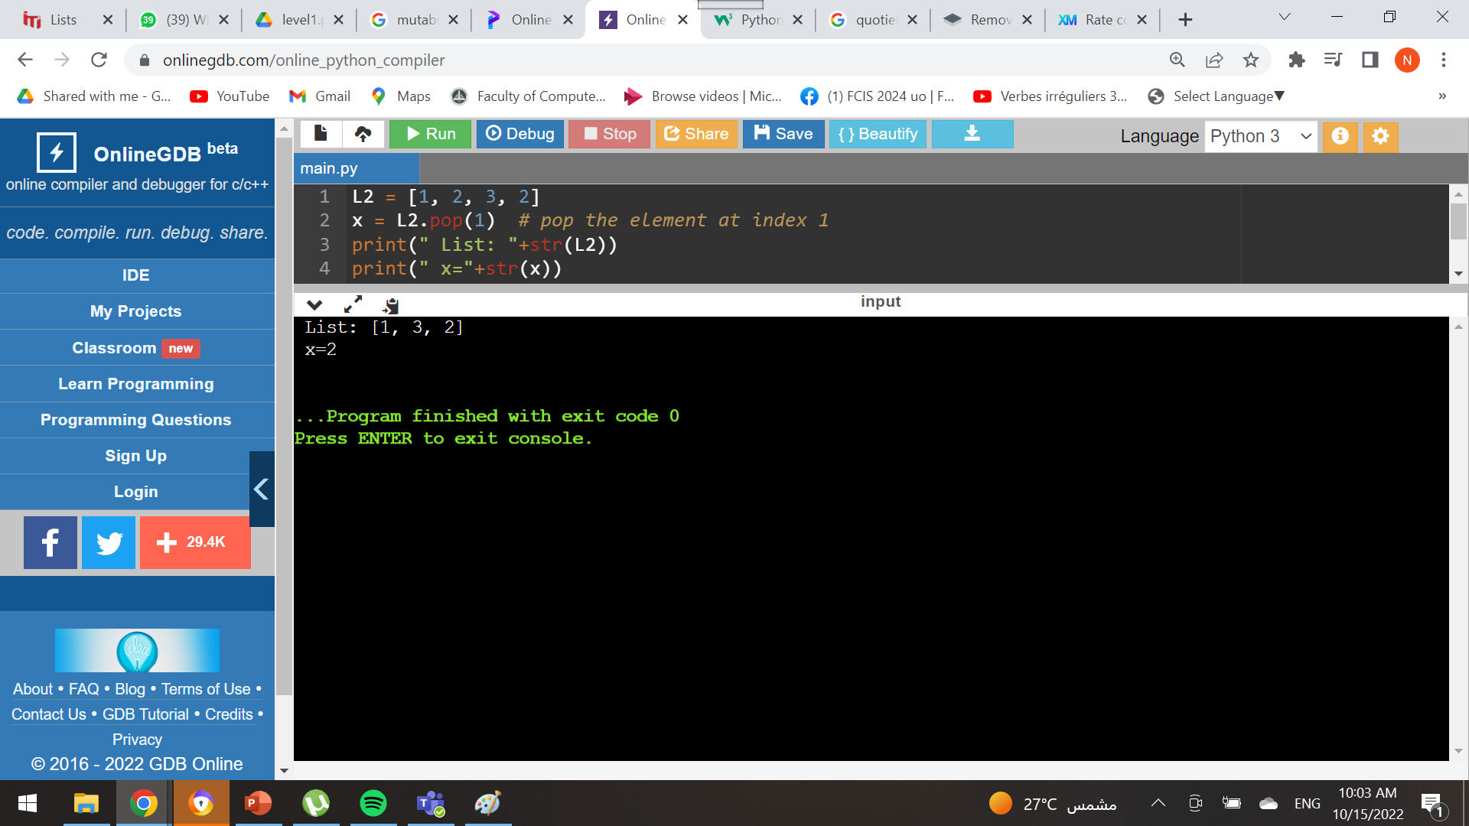

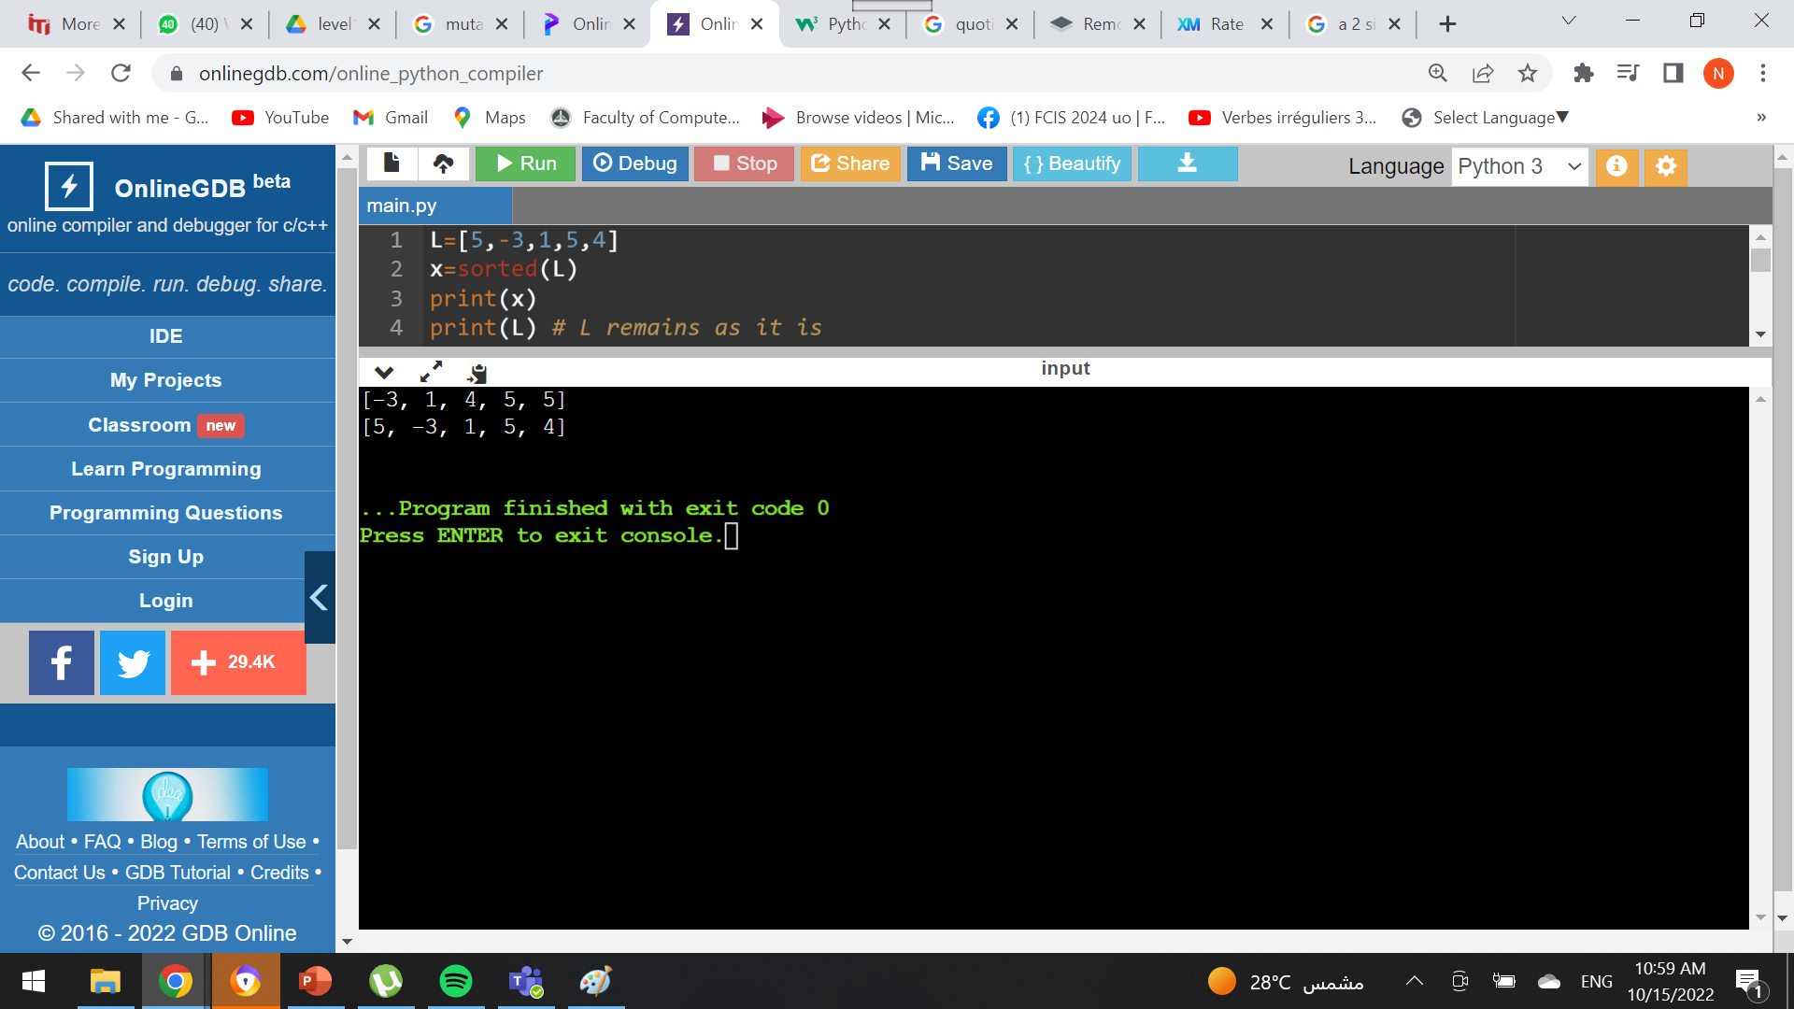

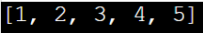
Some list functions
. append( x )
vs
. extend(list)
. pop ( )
vs
. pop(index)
del( L[index] )
vs
. remove(value)
. pop( )
Output:
Output:
. append( x )
Output:
Output:
. extend(list)
Output:
del( L [index] )
Output:
. remove(value)
Output:
sorted ( )
vs
. sort ( )
sorted(L)
Output:
.sort ( )
. reverse ( )

Slide 16

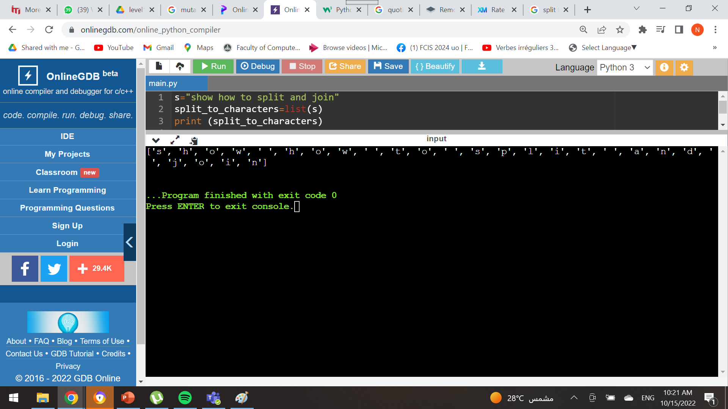
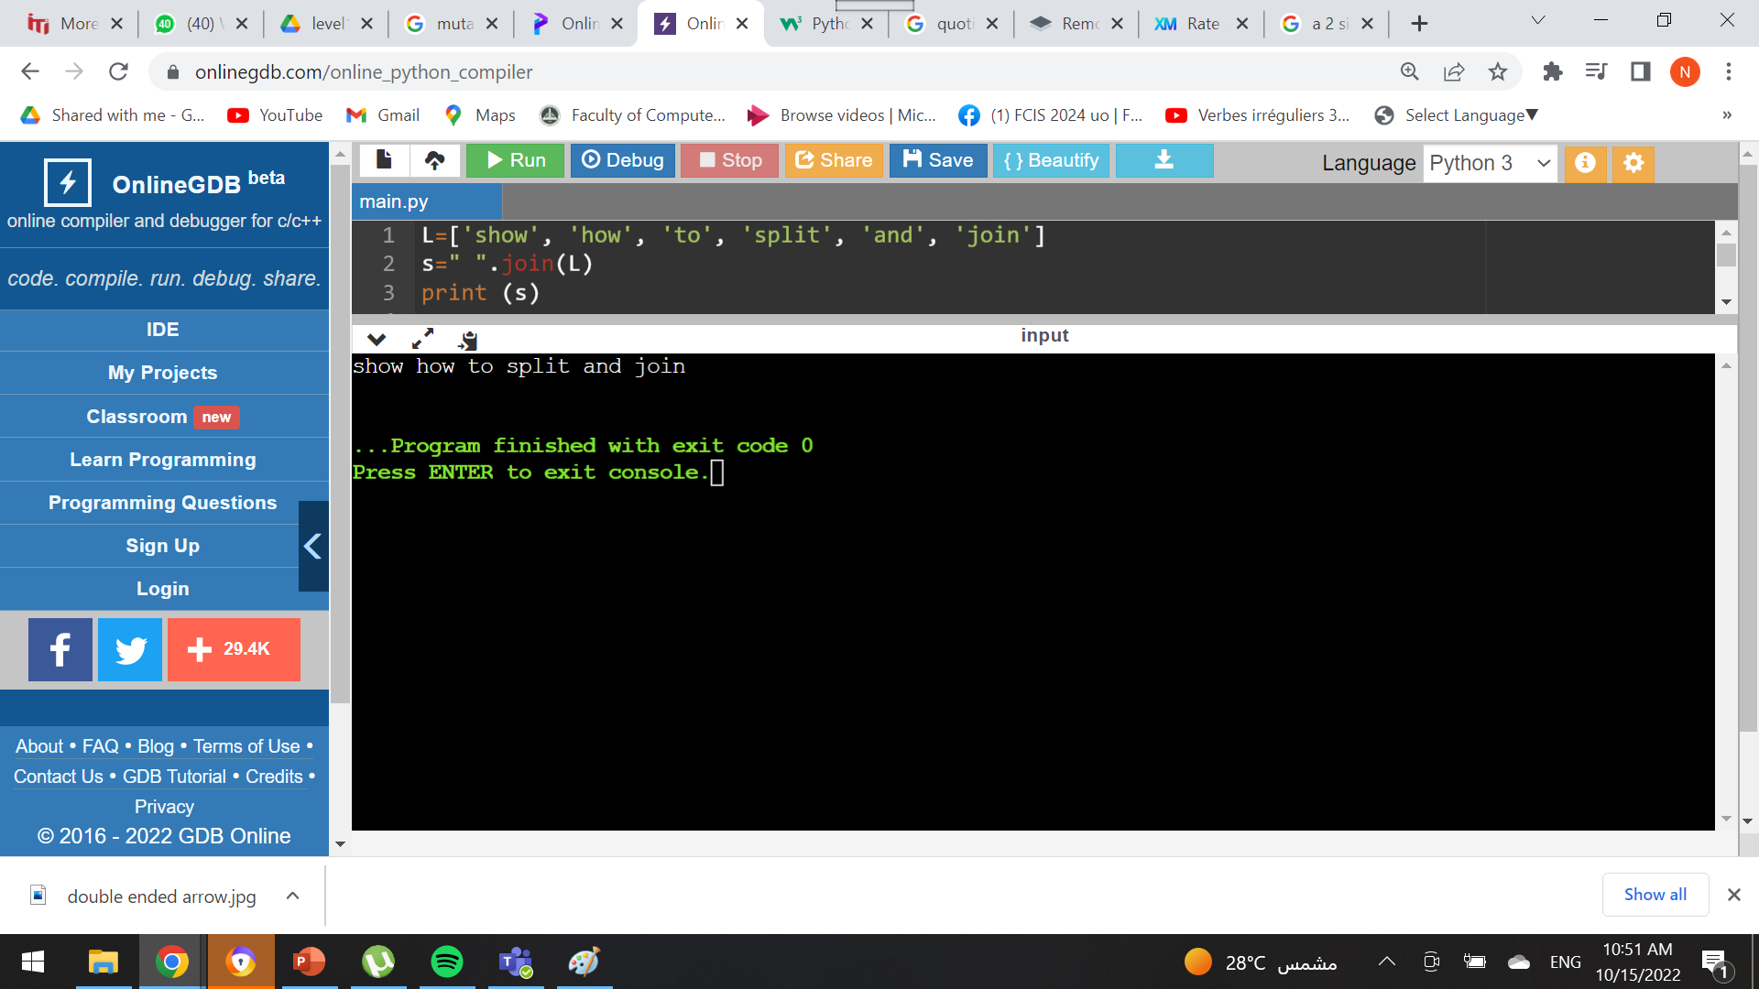
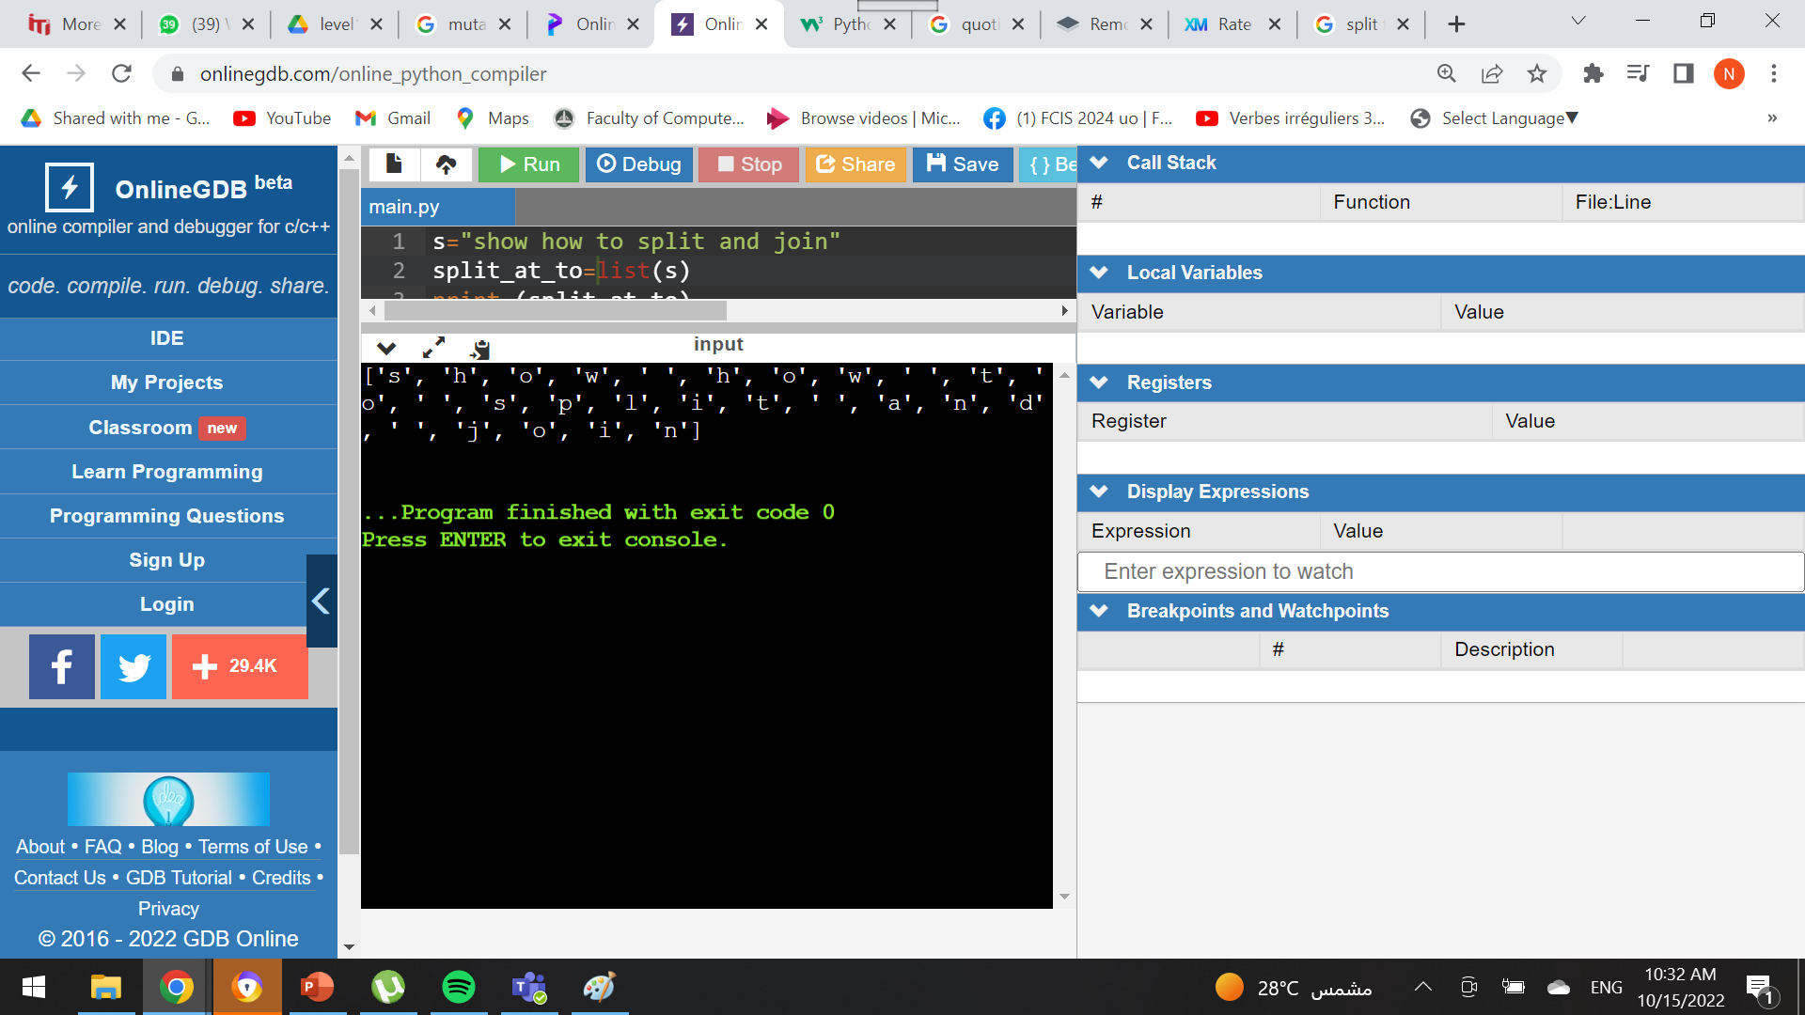
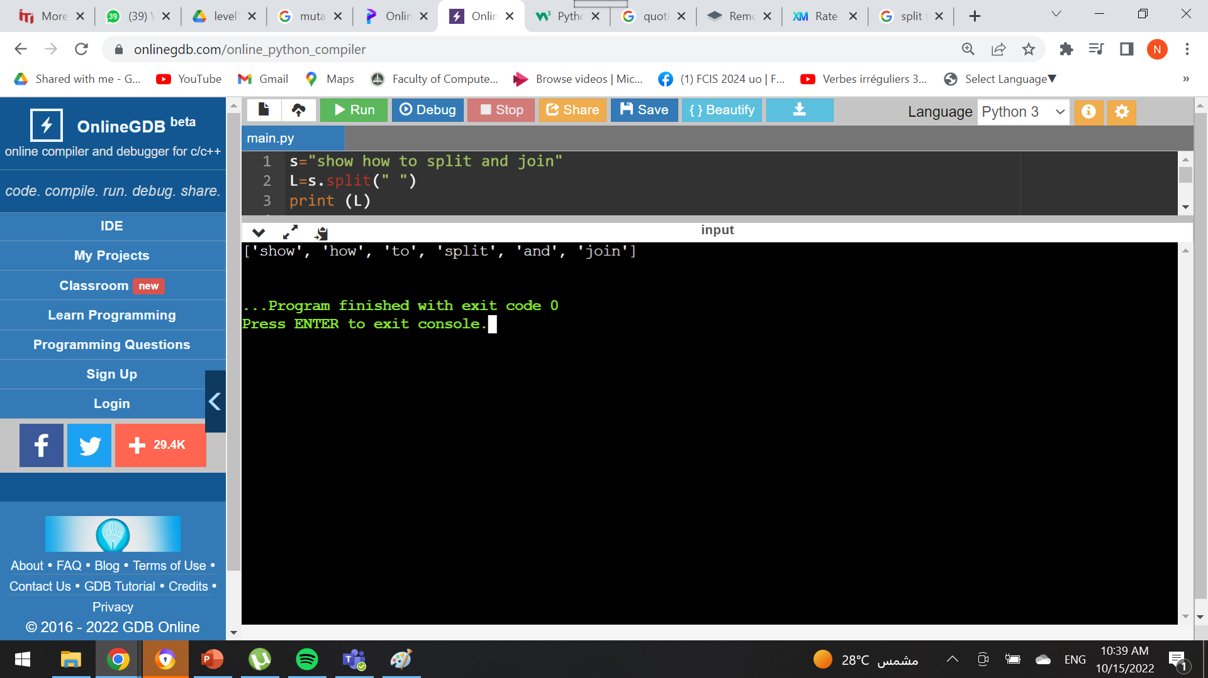
Strings & Lists
String
Lists
S = “show how to split and join” L = [‘show’, ‘how’, ‘to’, ‘split’, ‘and’, ‘join’]
String → List
S = “show how to split and join”
1)
Output:
2)
Output:
List → String
L = [‘show’, ‘how’, ‘to’, ‘split’, ‘and’, ‘join’]
1)
Output:

Slide 17
Assignment
DNA
RNA
RECV

Slide 18
To be continued ….
Tuesday 25/10/2022

Slide 19
Thank you
Naryman Ahmed​
narymanahmed@gmail.com

